Slide 1

Road Accidents Data Analysis and Severity Prediction
Anusha Das

Slide 2
Problem and target audience
This project aims to find out the different factors that contribute to a severe road accident and predict the severity of accidents.
The target audience here are the common citizens who will be made aware of the conditions that lead to an accident so that they can adopt better road safety habits, which will lead to lesser number of casualties and severe damages.
We can also incorporate this model in a real-time accident risk prediction model or develop a new real-time severe accident risk prediction. Policy implications of this project can be explored.

Slide 3
Data acquisition and cleaning
Countrywide car accident dataset of USA obtained from Kaggle(https://www.kaggle.com/sobhanmoosavi/us-accidents).
3.5 million records and 49 features in the raw dataset.
Missing values were either dropped or replaced with median values. Some redundant features which didn’t contribute to modelling or exploratory data analysis were dropped.
Cleaned data contains 2.3 million records.

Slide 4
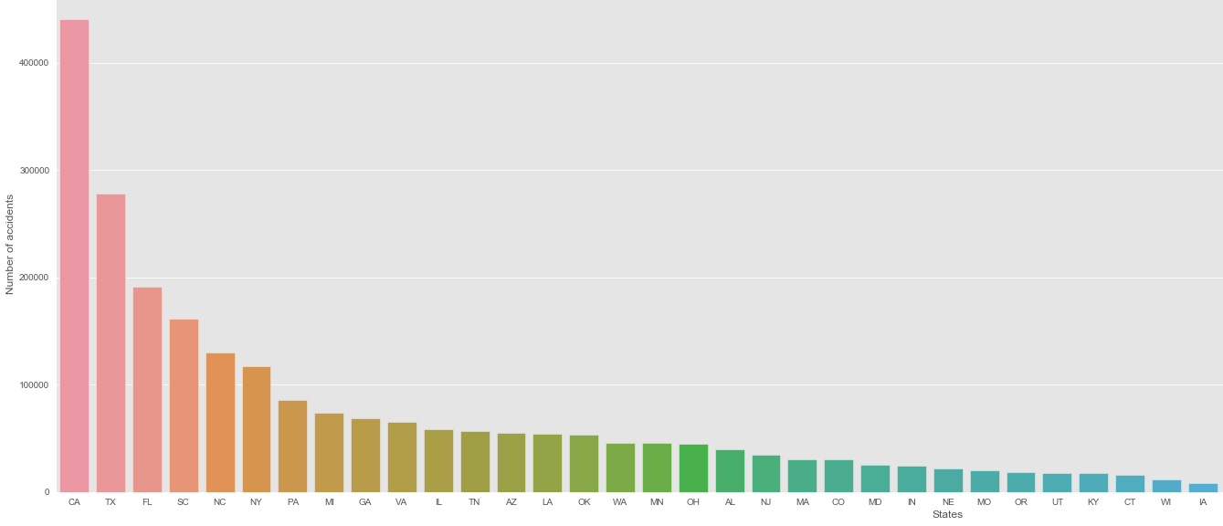
CA, TX and FL are the top 3 states with the highest number of accidents recorded

Slide 5
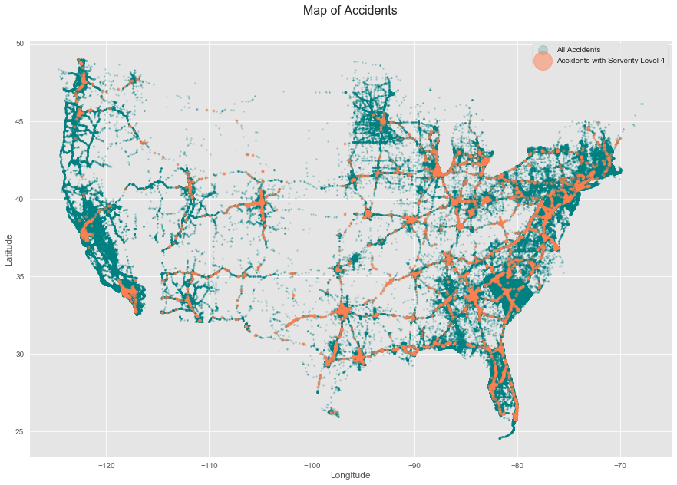
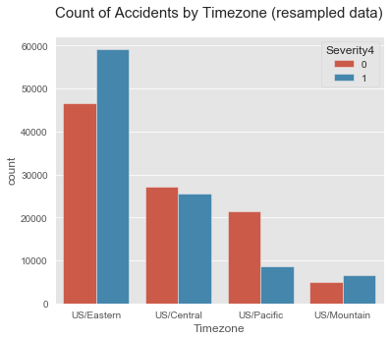
Eastern states had the greatest number of severe accidents

Slide 6
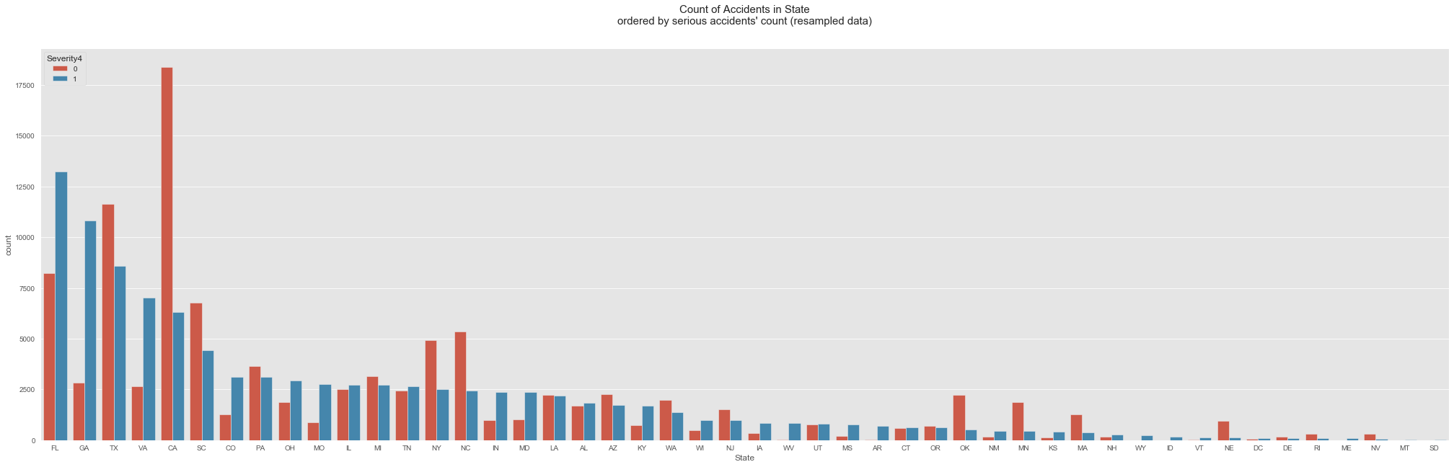
FL, GA and TX are the 3 states with most 'severe' accidents.

Slide 7
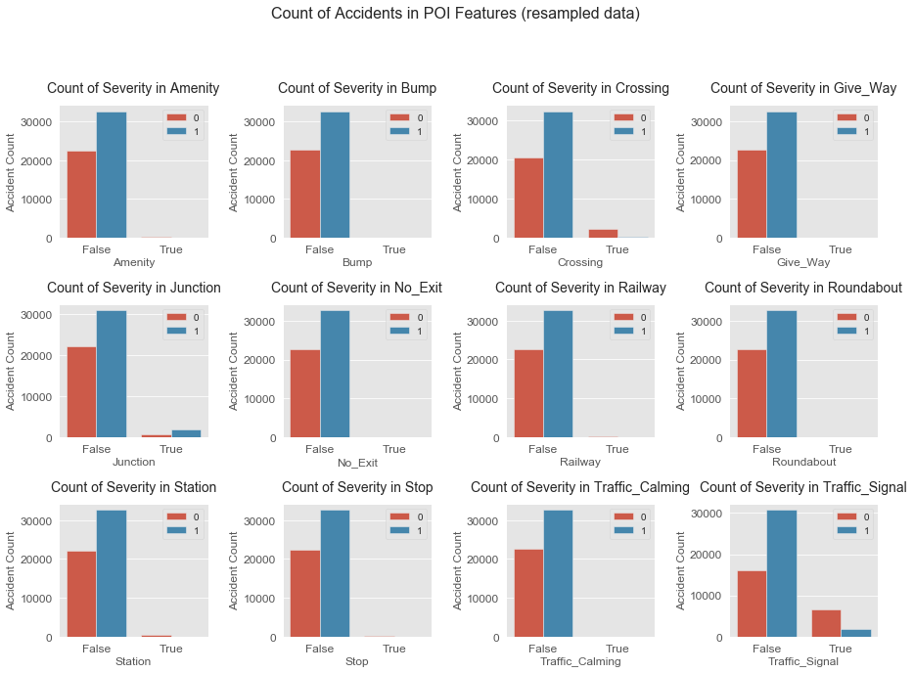
Accidents near traffic signal and crossing are much less likely to be serious. Accidents near the junction are more likely to be serious. Maybe it is because people usually slow down in front of crossing and traffic signal, but junction and severity are highly related to speed.

Slide 8
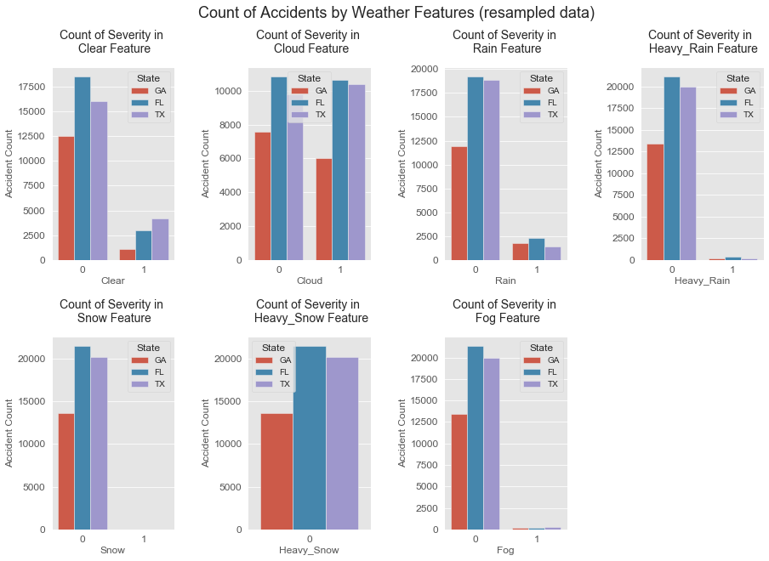
Most accidents occurred when the weather wasn't clear. The presence of clouds don't seem to affect count of accidents. We'd expect a high count of accidents in the presence of rain, snow or fog, but interestingly that is not the case here.

Slide 9
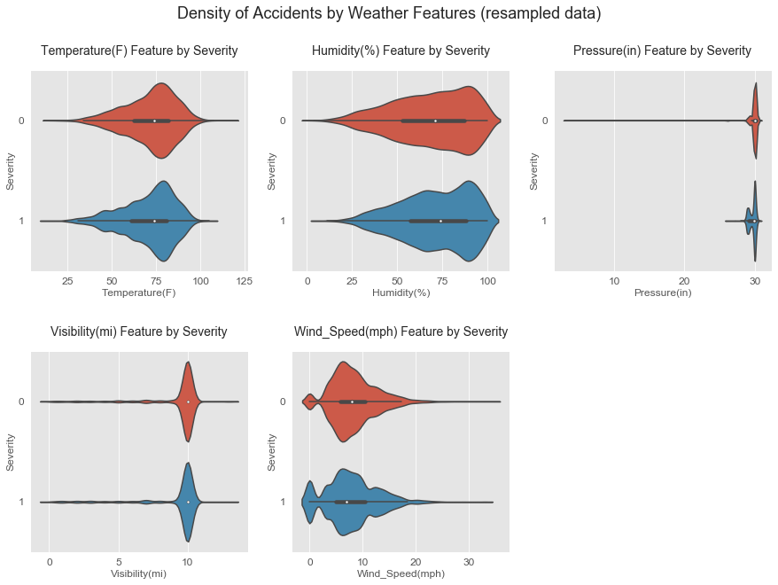
With increasing temperature and humidity, the accidents increase. This agrees with our previous observation of increase in accidents in the summer months. Statistics of visibility show that most of the values of visibility are around 10 miles.

Slide 10
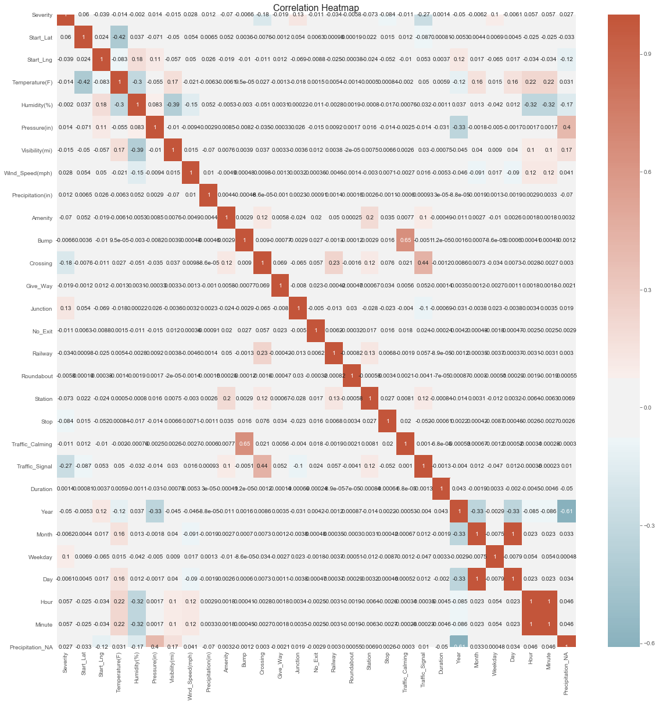
Severity does not show strong correlation with any of the feature and hence all the features are used for machine learning model.

Slide 11
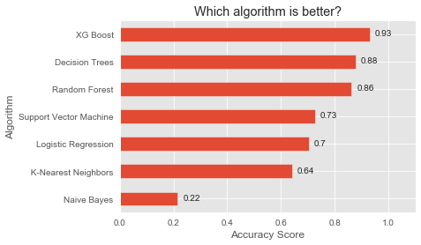
We find that XG Boost model with accuracy of 0.93 is best to predict severity of accidents.

Slide 12
Key Findings(Conclusion)
Country-wide accident severity can be accurately predicted with limited data attributes (location, time, weather, and POI).
An accident is much less likely to be severe if it happens near traffic signal while more likely if near junction.
Time series features are also very important. A serious accident is more likely to happen during office hours.
Weather features like pressure, temperature, humidity, and wind speed are also very important.

